Slide 1
Social Impact Review
2015-2016

Slide 2
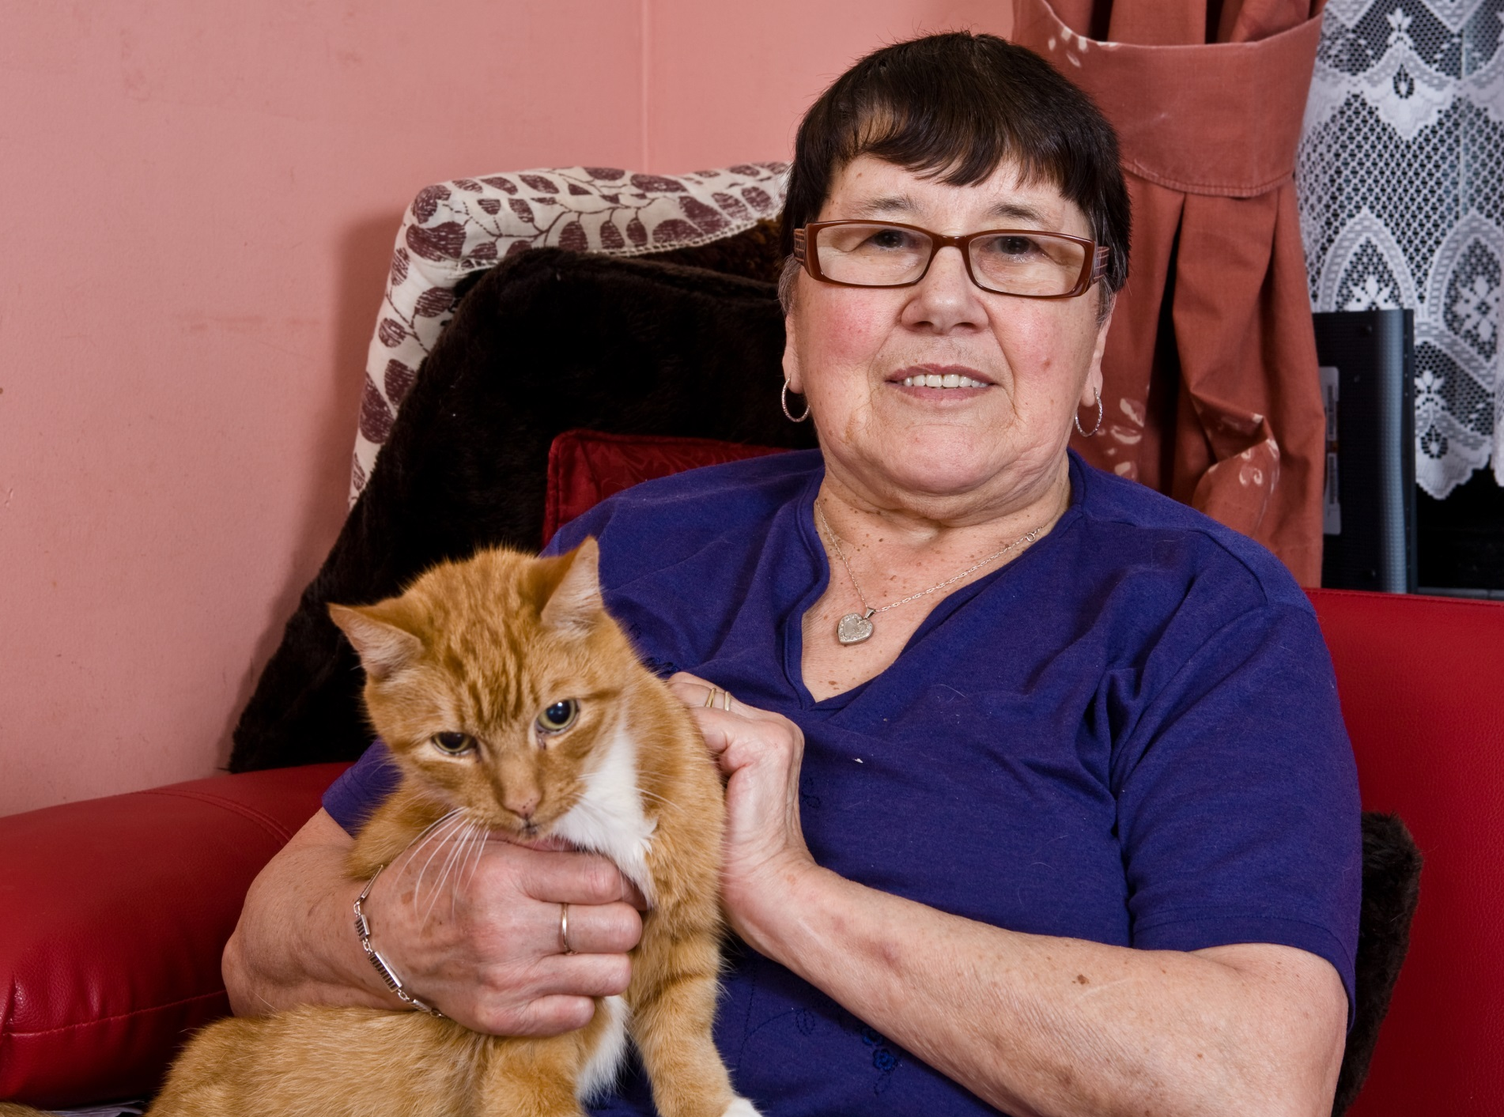

Slide 3
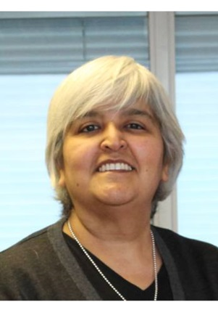
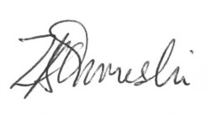
Welcome
I was appointed CEO in September of this year and it is with my pleasure that I introduce Housing for Women's’ first Social Impact Report. Despite a year of great social and economic change, Housing for Women has continued to grow and show our commitment to empowering women facing a variety of difficulties. We believe that housing women safely means more than just putting a roof over their heads. It means making it affordable on the most basic of incomes, so that women are not only paying rent, but they are able to afford, to attend college, maintain social lives, buy toys and clothes for their children and travel between boroughs to visit family and friends. It too means being safe, secure and approaching your landlord trusting them to fix and adapt the homes people rent in a timely manner.
This report aims to highlight the contributions Housing for Women have made to the communities in which we operate, to illustrate the project work we undertake and to showcase how our staff and volunteers continue to deliver services of the best quality and highest professionality with positivity and integrity. I hope you read enjoying the report and we look forward to continuing to helping women find confidence and lead the lives they deserve. Zaiba Qureshi
Bettering our services means responding to changes happening in all directions. We aim to continue to improve the lives of our clients via a holistic approach that empowers women in their personal and their professional lives, as we seek to support both them and their dependents.

Slide 4
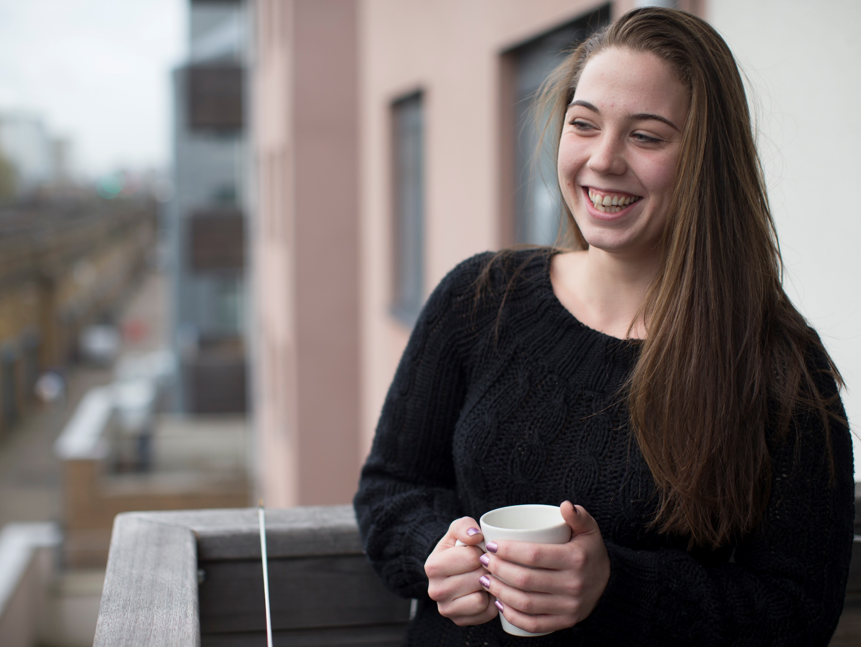
Our Services
Our work gives women access to skills they need to re-build their confidence and start a new life free from the challenges they once faced. Without safe and secure housing it is extremely difficult to sustain long-lasting relationships with family and friends, maintain a career and gain access to the provisions that are in place to safe-guard the most vulnerable. Housing for Women believe that everyone has a right to affordable housing regardless of circumstance. Through on-going reviews, surveys and evaluations we are able to adapt our services to the evolving needs of our clients so that they can continue to grow and find happiness with help from our teams of dedicated and specialist staff.
Our Mission
To work to empower women through providing good homes and services and challenging inequalities faced by women.
Our Values
Empowering: We enable our people to use their talents to provide the service our customers want. We aim to empower our customers to make choices and have greater control of their lives. We do it all the time.
Positive: Our people have a ‘can do’ attitude. We are positive about change and see it as an opportunity to develop.
Acting with Integrity: We are fair, open and honest and keep our promises.
Committed to excellence: We are always striving to do better and are enthusiastic about learning from our experiences to improve.

Slide 5
Our Work
The work we do is always performed with passion and with the women we service in mind. We are a unique organisation, in that we not only provide safe, secure and affordable housing for the most vulnerable of women, but we also offer specialist support services, grants to help with education and professional progress, as well as social events and activities that bring together women from our different communities and our staff. This year we have:
Supported 7 tenants applying for grants from Local Associations for major aids & adaptations
Supported 2 tenants having major aids & adaptations*
Facilitated 2 minor adaptations worth £608.03
Held regular coffee mornings in Earls Court, Greenwich and Streatham saving £282.71
Facilitated exercise classes in one of our properties giving £112.00
Made 78 Home visits to older tenants
*(with funding from Almhouse Trustees)

Slide 6
Our Finances
Housing for Women operates as both a charity and a housing organisation and so as such we are able to run our various services in part due to the rent we receive from our tenants, who are on low incomes, within General Housing, as well as grants, donations and corporate sponsors. The graphs below represent what money comes in from where and how it is spent.
Money in
How it is spent

Slide 7
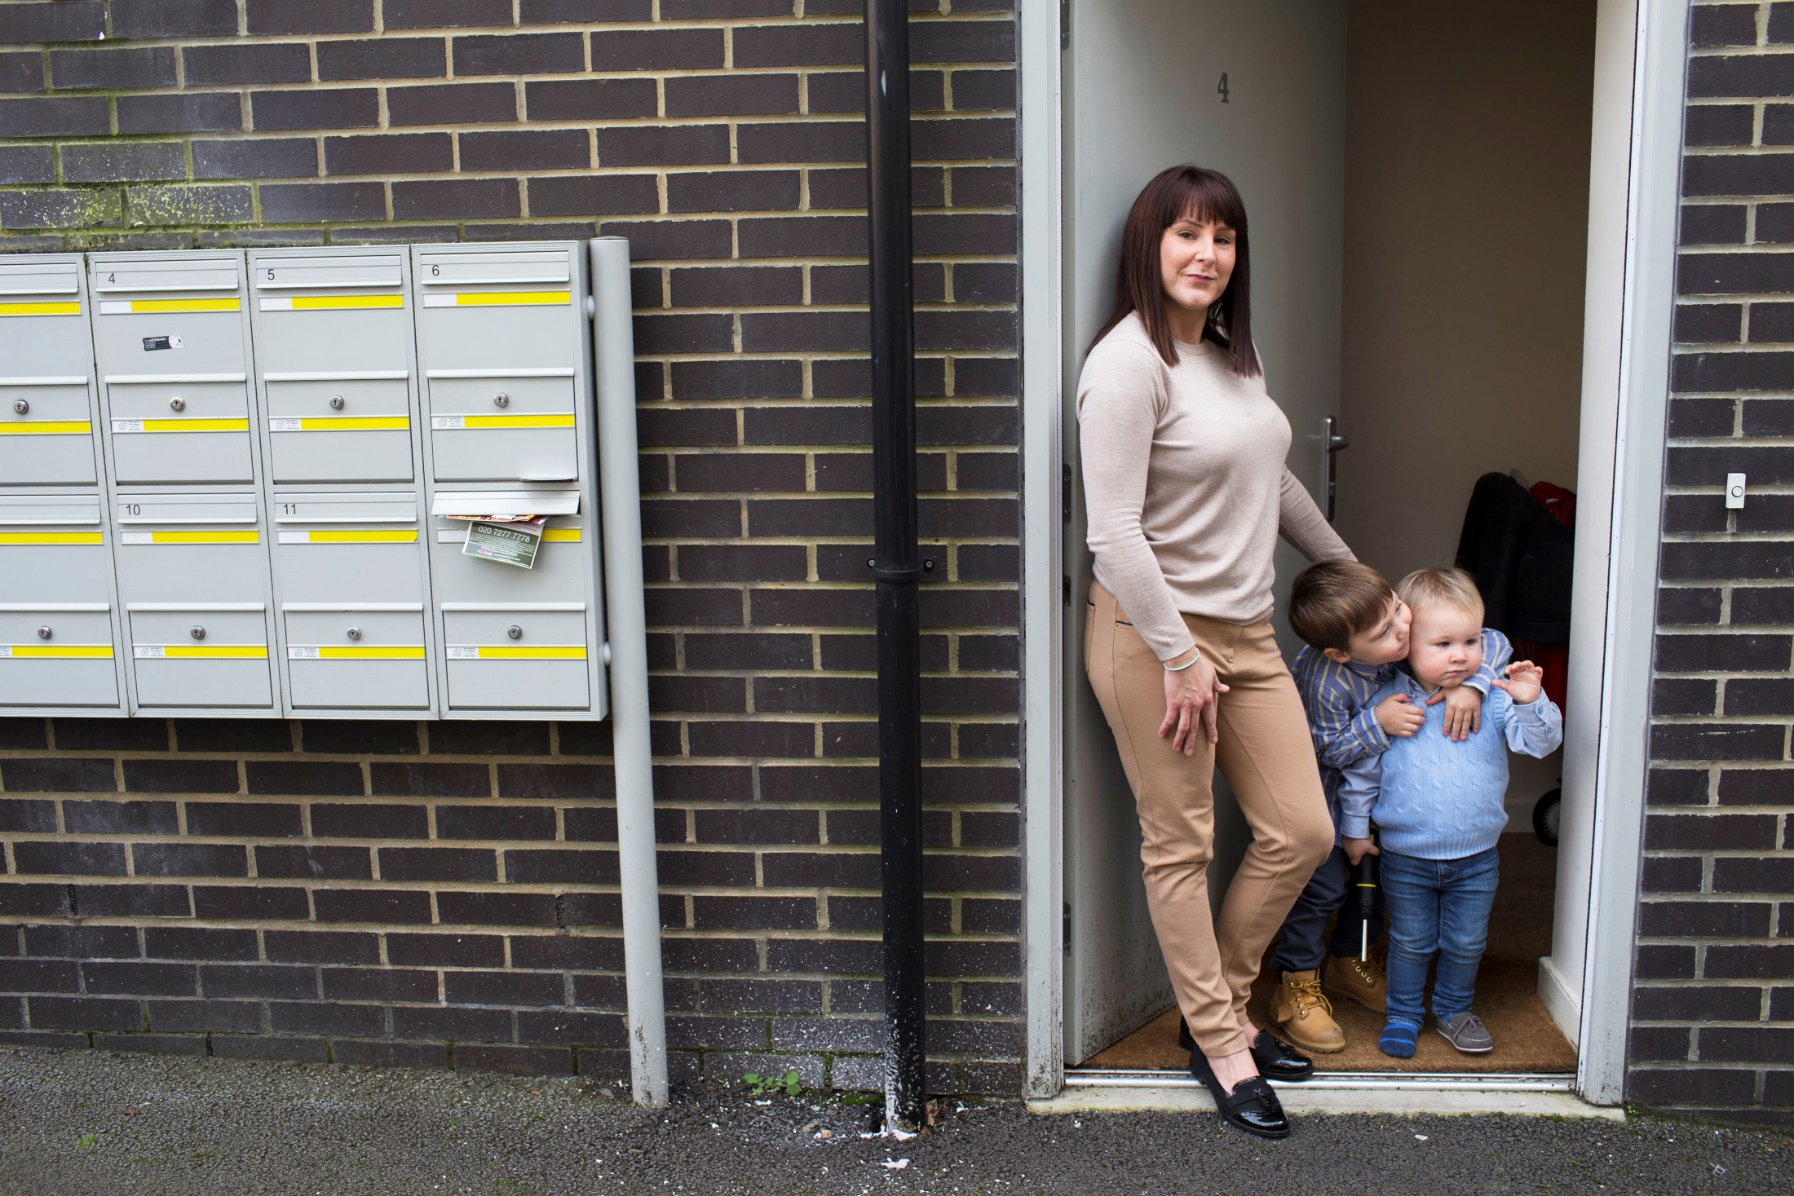

Slide 8
Your Support
Housing for Women rely on donations from both individuals and organisations. We have a number of high profile sponsors that allow us to fulfil our duties towards the women we seek to help and their children.
Spotify provided £200 worth of toiletries for the refuges and t-shirts for the women.
Habitat for Humanity decorated both Calder House and Hope House worth an estimated £3,000.
Boux Avenue donated pyjamas, underwear, dressing gowns and other items of clothing totalling £400.
Merlin’s Magic Wand gifted 40 tickets to Shrek costing £675.
Kinleigh, Folkard & Howard gave Christmas gifts to the Greenwich Refuge for mums and kids at a value of £500.

Slide 9
Friends of Housing for Women
Friends is made up of anyone associated with Housing for Women who believes in our mission and wants to support us, with a donation of £20 to join. The group aims to contribute to the work of Housing for Women by delivering ongoing support and advocacy, as well as offering a community for our supporters to connect and network.
The Friends Group give a number of grants and donations in order to provide women opportunities that may be difficult to find funding for or services not provided locally.
Friends assist in making seemingly-straightforward tasks for some people accessible for the most vulnerable- including family trips. With these opportunities our clients self-esteem improves and they can continue to foster long-lasting relationships with their families.

Slide 10
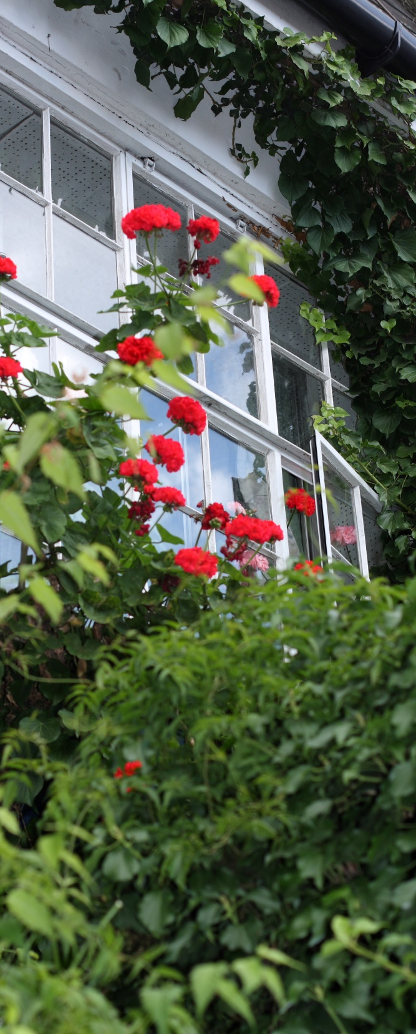
Our Refuges
Within our refuges we provide safe and secure housing for women who have experienced domestic abuse, trafficking for sexual and domestic servitude and mothers leaving prison.
These houses not only provide homes for women and their children but we provide specialist support so that both the women and children we work with can gain independence and empower themselves. During 2015-2016:
Ealing Refuge housed and helped 103 women and 30 children
Merton Refuge housed and helped 41 women and 21 children
Greenwich Refuge housed and helped 161 women and 65 children
2015/16 Greenwich Floating Support: 94 (we do not offer FS yet in Ealing/Merton)
Between them the refugees received and responded to 3044 telephone calls from vulnerable women
*All figures are from 1/10/15 – 30/9/16

Slide 11
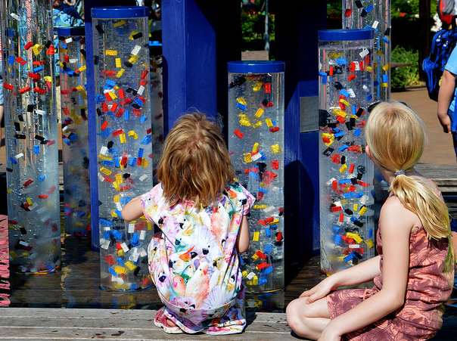

Slide 12
Short Breaks
Sponsored by Friends of Housing for Women, service users with young children were given the opportunity to apply for a small grant that would allow them to take a short-break as a family.
After the trip we surveyed the families to see if and how their experiences on the holiday impacted them and their relationships.
One service user said that she “is now looking forward to creating a new life with my daughter in a stable home.”
100% of the parents said that the trip allowed them to spend quality time together as a family- that it empowered them to get along better as a family.
This short break gave me an opportunity to think about the plan for future. That I need to work and earn some money and plan for a holiday with my children.
- Service User
75% of the mothers who took the short break said that it helped them to cope better with daily challenges.

Slide 13
100% of those surveyed indicated that the trips away reduced their stress levels and causes them to worry less.
“The break helped me to reduce stress and worries. [Now] every time I am very stressed I go out either to the park alone or with the children to ease the stress.”
100% said their children had fun and created happy memories together.
“They still remember our trip to LegoLand and they always say they want to go back. They draw pictures.”
75% of the women said it enabled them to feel more optimistic about the future.
Holidays mean we can spend quality time together as a family without thinking about bad things or the past. - Service User

Slide 14
Tenants Training Grants
For over five years Housing for Women have been offering small grants of up to £500 to tenants improve their opportunities of finding work. All residents are welcome to apply for the grant, which can be used for such things as course fees, equipment, childcare, professional fees, driving lessons.
In the year 2014/15 a budget of £7,000 was agreed which would offer 14 women the chance to receive the grant.
There were 14 applicants for the grant and 1 of these were from general needs residents and 13 were from Supported Housing. There were 5 less applicants than last year and a disappointing drop from general needs residents
The average age of applicants was 34. The youngest applicant was 25 and the oldest was 49.

Slide 15
Grants were awarded for the following uses:
HfW paid course fees for 5 people
5 people received laptops with suitable software
1 people received help with travel costs
4 people received suitable clothing for interviews or a new job
5 people received equipment which included books, specialist uniforms and cleaning equipment for a cleaning business start-up
The above items total £5,987 for this financial year. All tenants bar 2 applied for the full £500 or more.
From the figures obtained we know that the grant is working well and is opening doors for women.

Slide 16
Jennifer's Story
Jennifer came to Housing for Women just over a year ago, after fleeing domestic abuse at the hands of her husband. Jennifer was brought over to England by her husband from Mauritius. Knowing little about the country she was forced to leave behind her career in the hospitality sector, her family and her friends. She left behind the life she had made for herself because her husband promised they would live happily together in the UK and he would provide her with everything she needed. Unfortunately, the promises Jennifer's husband made her did not come to fruition, but instead she was held captive in her house, not being allowed to leave or learn more about the new country she was now meant to call home. Jennifer faced many hardships at the hands of her husband. He was emotionally manipulative, controlling and threatening. He would tell her how he had spent nights with other women and would criticise her appearance to demonstrate his power and dissolve her confidence. Daily routines for Jennifer included being kept financially dependent on her husband and isolated from her family back home. Jennifer's husband was not the only one who was domestically abusive towards her but his family too would control her behaviour and social interactions, all whilst berating her and approving and encouraging her husband’s abuse. It was not until Jennifer fell pregnant with her second child did she consider herself a survivor of domestic abuse. It was a midwife who spotted signs of abusive behaviour and informed her of social services who then directed her to Housing for Women. Jennifer made the brave decision to leave the house in which her life had been made unbearable after her husband laid hands on her eldest child. She packed up with a new baby in her arms and toddler by her side and was welcomed with love and support at one of our refuges. Jennifer received counselling and therapy, as did her children and began to rebuild her confidence and self-esteem. She speaks fondly of the refuge and the staff that helped her and continue to do so. Jennifer now has her own home for herself and her children where they are making happy memories. Jennifer says:
“I look at myself in the mirror and I am worthy. I am happy. I am strong. I survived.”

Slide 17
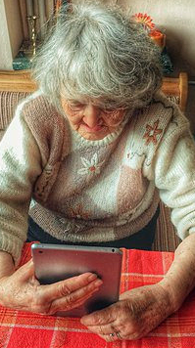
Online Activity
With older tenants making up a 31% of our customers, it important to us that they do not feel left behind in an increasingly technological based society. As Housing for Women look forward to improving our online resources it is key that we take our service users along with us. To achieve this 3 women between 65 and 80 were given Breezie tablets. The Older women tenants used them for amongst other things:
Email Facebook Photos Pension information Making enquiries Reading the newspaper

Slide 18
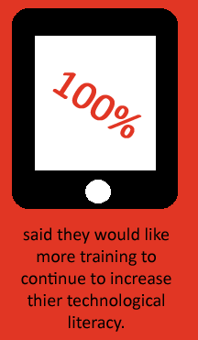
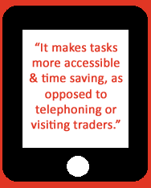
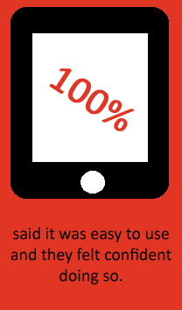
100% of the older women said that they had considered using this type of technology before they received their Breezie tablet. With one user saying that “cost was a big factor” that was stopping her. Considering this, we have made a social impact- saving service users time, with use of the tablet and not having to find their own, along with providing the training on how to use it, with one service user saying that it was “even easier than expected [and she is] getting better the more [she uses] it.”

Slide 19
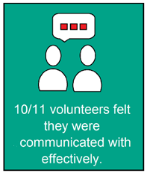
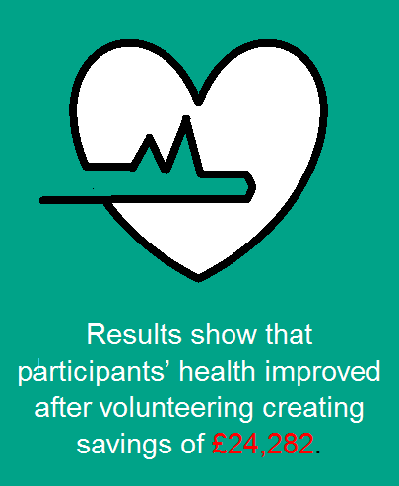
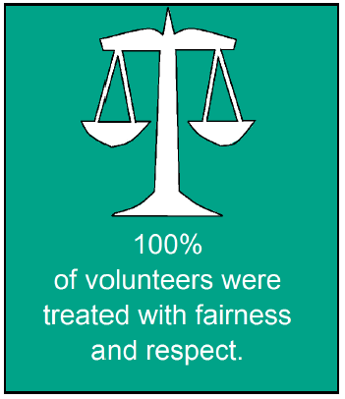
Volunteering
Volunteers are key to the work we do and the services we provide. In exchange for their time we hope to give them back the skills and confidence they need to excel in future employment. Volunteering too helps to build stronger and richer communities, which allows for the following to be achieved:
Through my journey, my managers and colleagues have been wonderful as they have fostered my growth. I therefore come out an empowered product and more than ready to take on bigger tasks. -Supported Housing volunteer

Slide 20
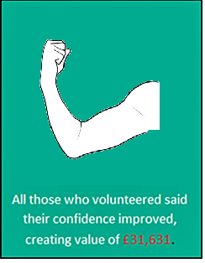
72% agree that volunteering at Housing for Women has helped them to gain job- specific skills and increase their resilience, improve relationships or re-build their lives.
12/14 volunteers volunteered at least once per month amounting to £42,762 in donated time.
All but one volunteer who answered the question agreed that they were given opportunities to develop.
After volunteering, 54% of volunteers felt more able to control what was happening in their lives.
9/13 respondents were employed in some capacity after volunteering. Two more than when they started, saving £24,068.
Five (45%) former volunteers agreed and one (9%) strongly agreed volunteering with us helped them to increase their life satisfaction.

Slide 21
Volunteer Case Study
“
I applied to become a Refuge Support Volunteer at Housing for Women because I was doing a Social Care Level 3 course and needed some hands–on experience.
From the beginning I knew I wanted to work in this field. The work was a lot to take in but I loved it because I did not have any professional background in Domestic Violence and I was finally working face to face with women who had escaped it. Unfortunately I had some personal experience but this was not an obstacle. I think it helped me because although mine was a different situation to theirs, I could relate to what women we supported were going through. Seeing that I could help real women going through such difficult experiences made me wanted to help even further.
At the beginning I shadowed an experienced case worker and once I was ready I started having my own cases supporting women with anything they needed to improve their situations, form listening to their stories, to advocating on their behalf to other agencies. I felt I was empowered and supported all the time by everyone. I was part of the team and I think we all pulled our weight together.
Initially I volunteered both with children and adults. Although I learnt a lot and enjoyed the opportunity I realised that that I was more inclined to work with women rather than with children. Having the opportunity to work both with children and women helped me to identify where my passion was and gave me important skills to identify needs of women with children.
I had been volunteering for five months in one of the refuges when a vacancy for a Refuge Support Worker at Housing for Women was advertised. I believe that my supervisor, and the team, saw that person in me because I was encouraged and supported to apply for the job
I gained a lot of experience in the field of Domestic during the time I volunteered. I realise that now a days everything is about your experience and that a qualification on its own is not enough. Three months ago I became a paid member of staff. I believe that volunteering helped me to be more confident, to enhance my skills and gave me the insight and experience I needed to get a paid job.
”

Slide 22
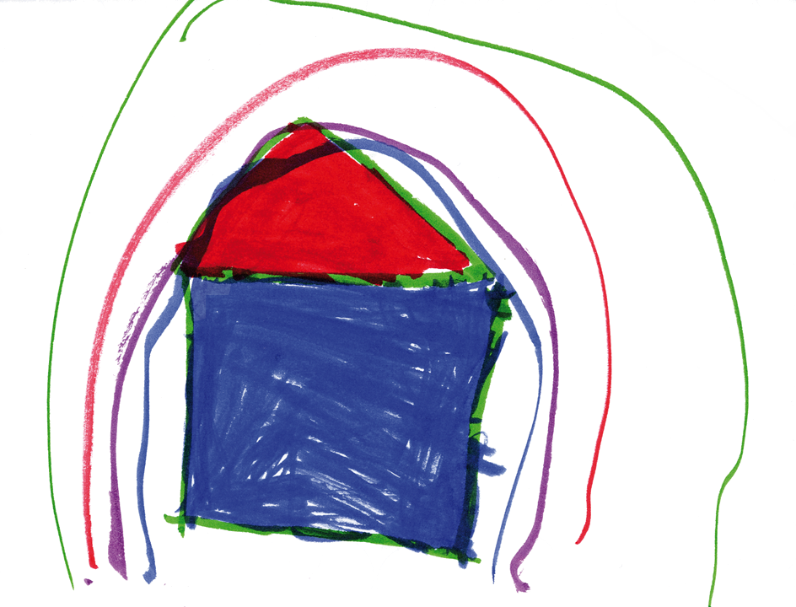
Picture drawn by one of our service users children
To procure these figures the HACT Value Calculator and Social Value Bank were used to create an Impact Valuation Statement. The data used in these tools are taken from large national surveys and then analysed to isolate the effect of a particular factor on a person’s wellbeing, creating a Wellbeing Valuation. Further analysis then reveals the equivalent amount of money needed to increase someone’s wellbeing by the same amount.
Wellbeing Valuation is the latest thinking in social impact measurement. Data was also gathered from surveys, user feedback and customer testimonies. All person information is anonymised.

Slide 23
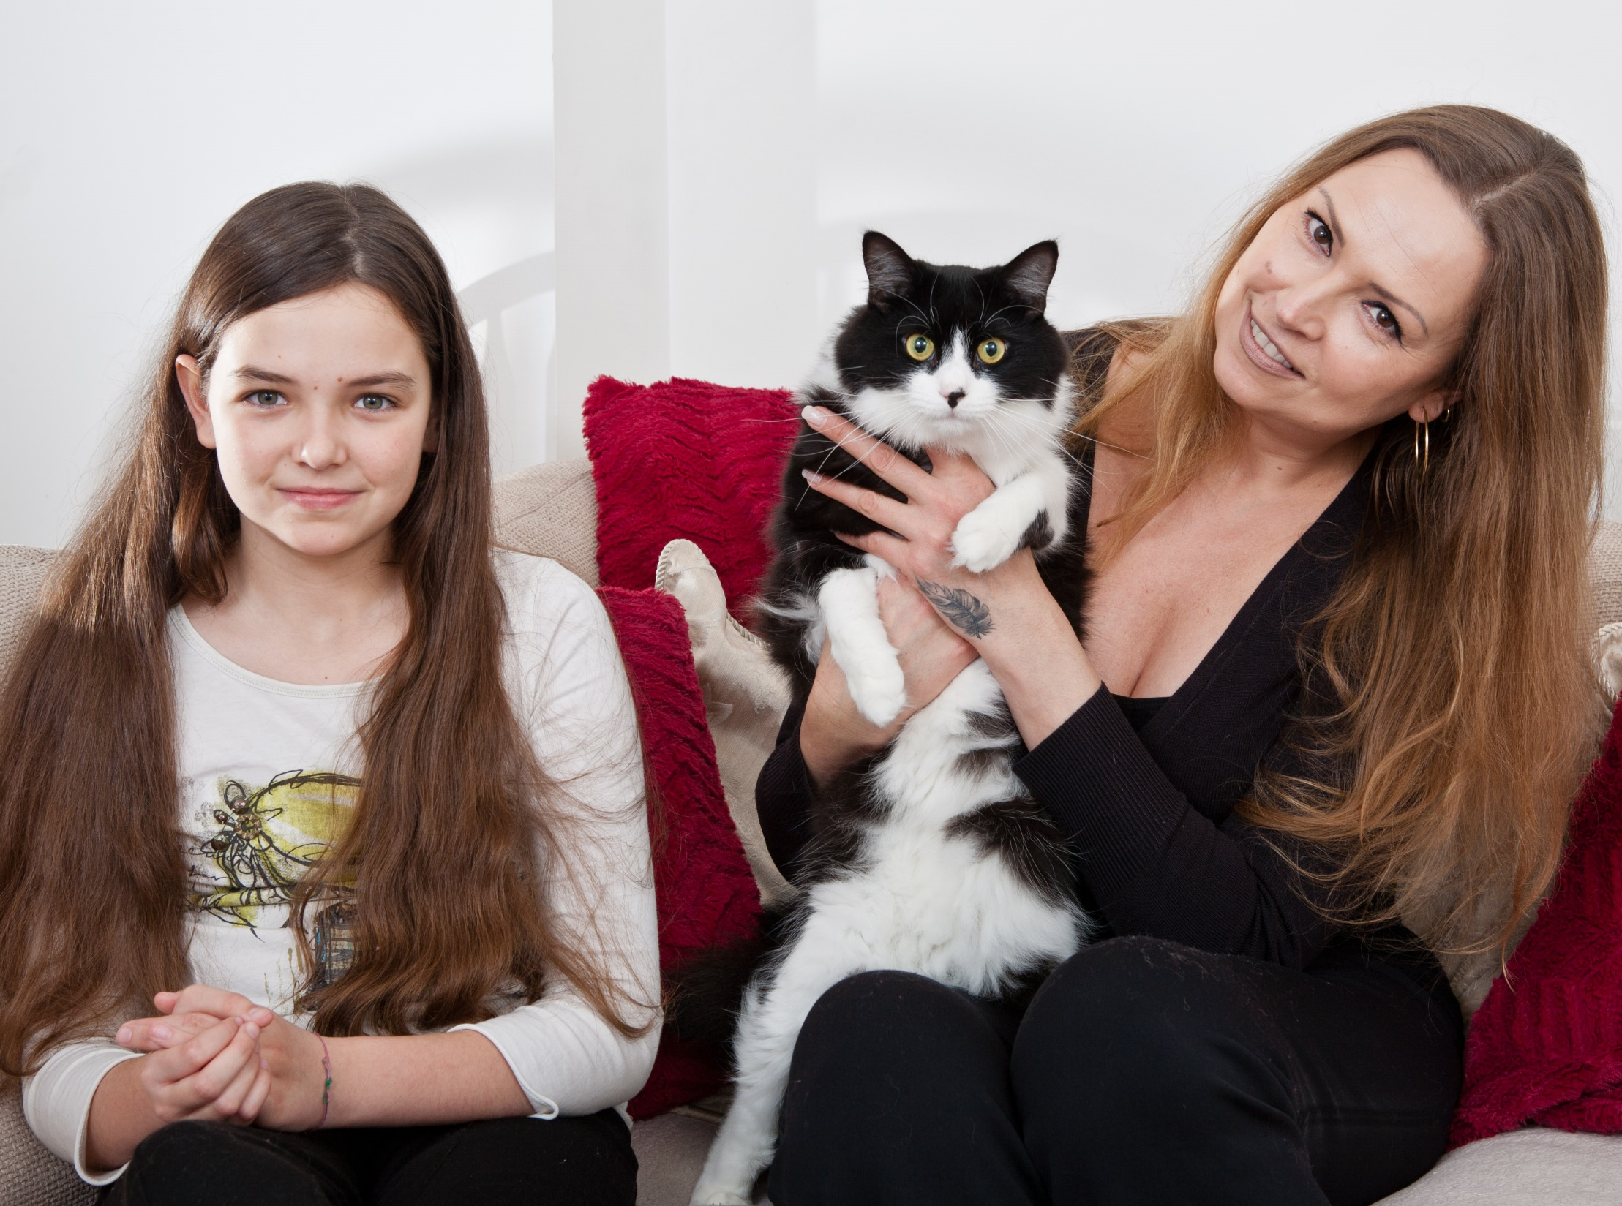

Slide 24
Housing for Women
6th Floor Blue Star House 234-240 Stockwell Rd London SW9 9SP 020 7501 6120 info@h4w.co.uk

